Slide 1

Advanced Machine Learning Techniques
Session - 3

Slide 2
Agenda
Revision
T-SNE
Introduction
Steps
Example
Implementation

Slide 3
Advanced MLT – Course overview
Dimensionality reduction
Principal Component Analysis
Linear Discriminant Analysis , Locally Linear Embedding
T - Distributed Stochastic Neighbour Embedding
Clustering and Mixture models
Machine Learning Project Life Cycle
ML deployment
Deployment using FastAPI and cloud platforms

Slide 4
Approaches to dimensionality reduction
Projection
Manifold Learning

Slide 5
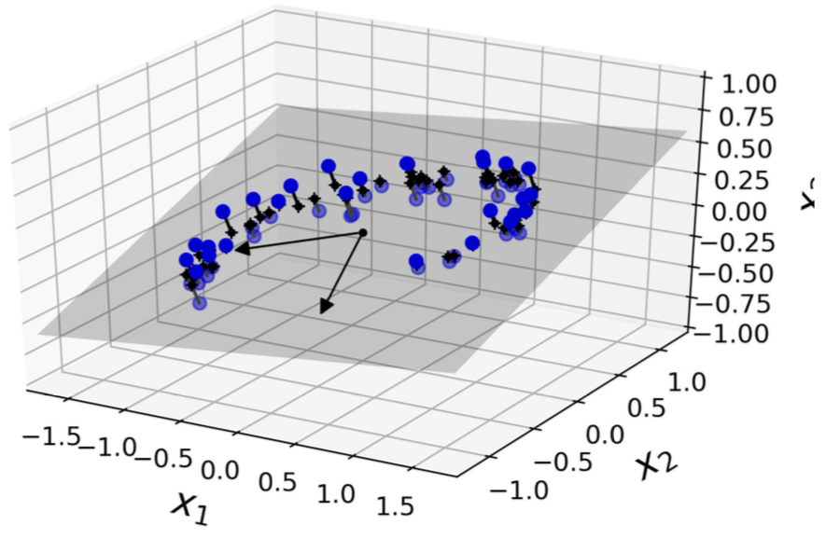
Projection

Slide 6
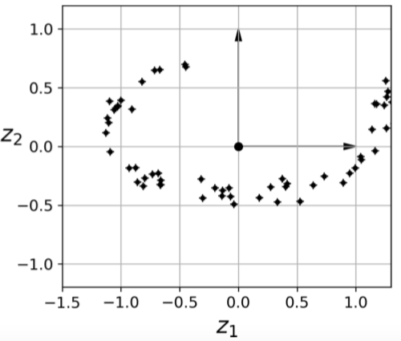
Projection
Results in info loss

Slide 7
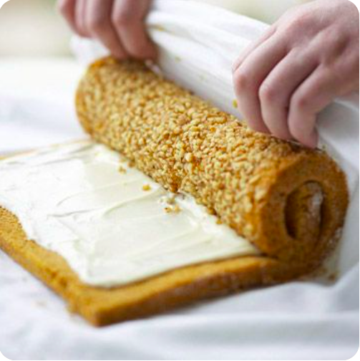
Issue with projection: Eg swiss roll

Slide 8
Issue with projection: Eg swiss roll

Slide 9
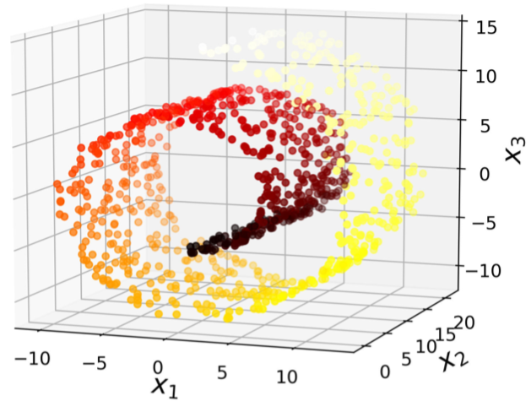
Swiss roll data set

Slide 10
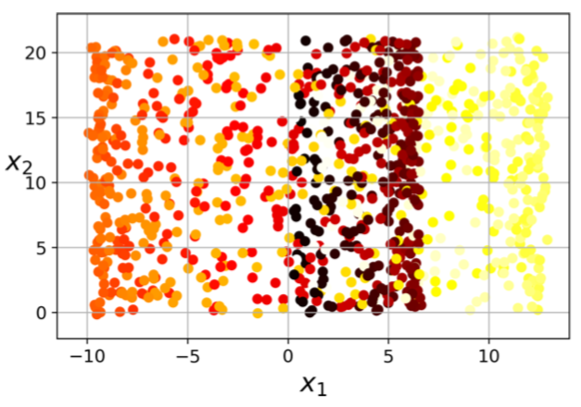
Projection of swiss roll data sets

Slide 11
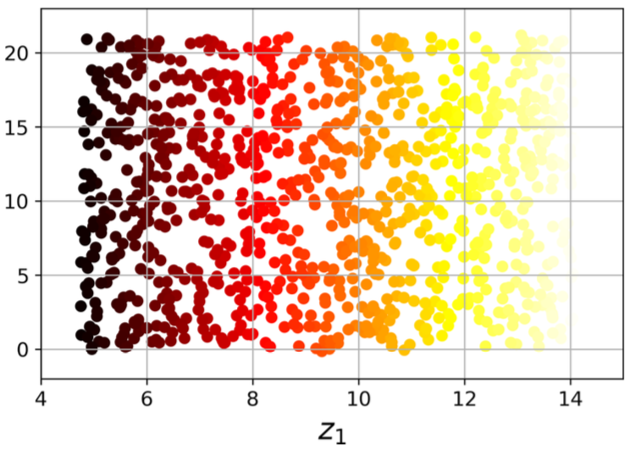
Manifold Learning: Unrolling

Slide 12
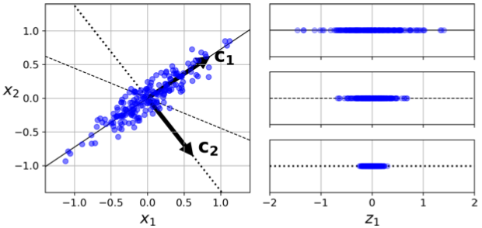
Principal Component Analysis - PCA
Identifies the right hyperplane that is closest to the data, then projects into it.
Right…?

Slide 13
Principal Component Analysis - PCA
Choose the hyperplane which preserves the maximum amount of variance.
Principal component: the axis which has this property.
For, 3D or higher, choose another axis, which is orthogonal(perpendicular) to the PC, which preserves maximum variance.

Slide 15
LDA and LLE
Linear Discriminant Analysis
PCA vs LDA
Steps involved in the process
Implementation
Locally Linear Embedding
LlE vs PCA/LDA
Steps involved in the process
Implementation

Slide 16
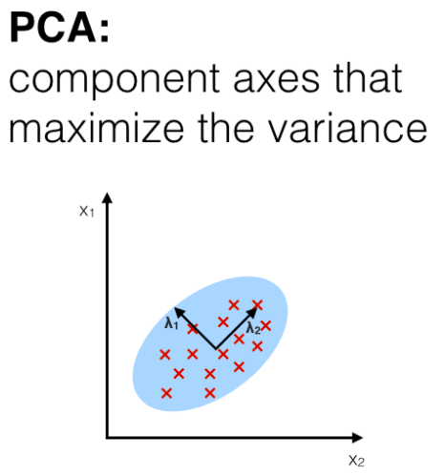
Linear Discriminant Analysis

Slide 17
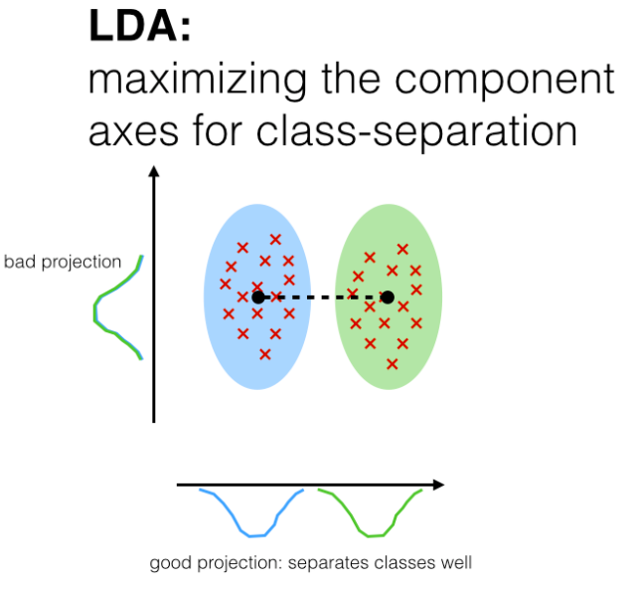
Linear Discriminant Analysis

Slide 18
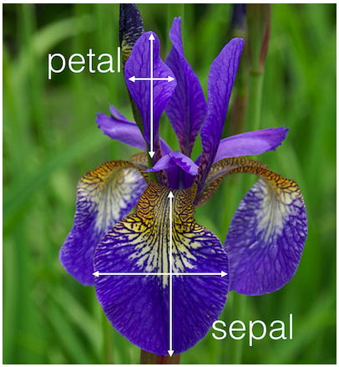
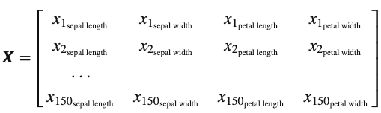
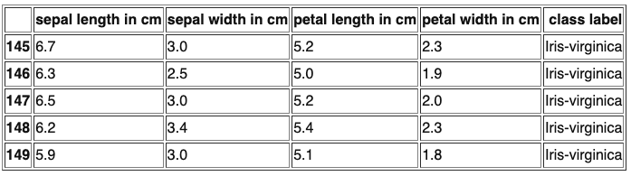
LDA: Eg.

Slide 19
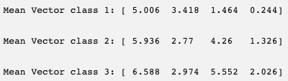
LDA Steps
1. Compute mean vector of each class.

Slide 20
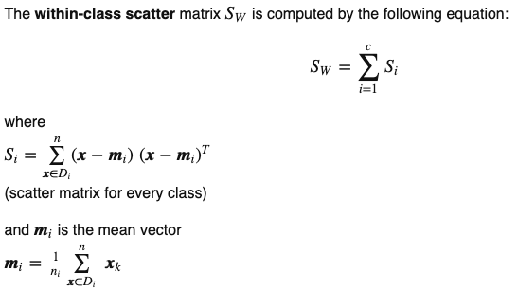
LDA Steps
1. Compute mean vector of each class.
2. Compute scatter matrices for in between and within classes.

Slide 21
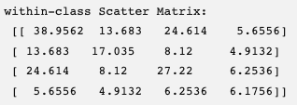
LDA Steps
1. Compute mean vector of each class.
2. Compute covariance /scatter matrices for in between and within classes.

Slide 22
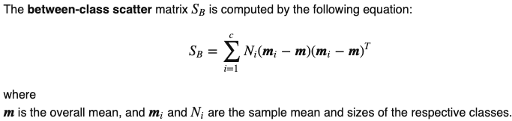
LDA Steps
1. Compute mean vector of each class.
2. Compute scatter matrices for in between and within classes.

Slide 23
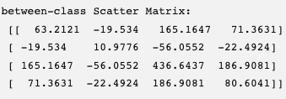
LDA Steps
1. Compute mean vector of each class.
2. Compute scatter matrices for in between and within classes.

Slide 24
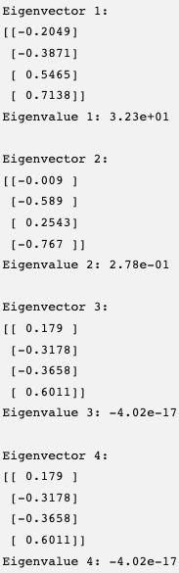
LDA Steps
1. Compute mean vector of each class.
2. Compute scatter matrices for in between and within) classes.
3. Solve matrix [Sw ^{^-1} . SB] to get eigen values and eigen vectors.

Slide 25
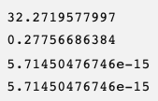
LDA Steps
1. Compute mean vector of each class.
2. Compute scatter matrices for in between and within) classes.
3. Solve matrix [Sw ^{^-1} . SB] to get eigen values and eigen vectors.
4. Sort eigen values in decreasing order and choose k eigen vectors with highest eigen values. Create W by taking those eigen vectors as columns

Slide 26
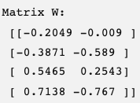
LDA Steps
1. Compute mean vector of each class of the set X..
2. Compute scatter matrices for in between and within) classes.
3. Solve matrix [Sw ^{^-1} . SB] to get eigen values and eigen vectors.
4. Sort eigen values in decreasing order and choose k eigen vectors with highest eigen values. Create W by taking those eigen vectors as columns.
Obtain Y=X.W, this is the transformed feature surface

Slide 27
Locally Linear embedding
Manifold learning
Focuses on nearby points of each data point
Distance is locally preserved.

Slide 28
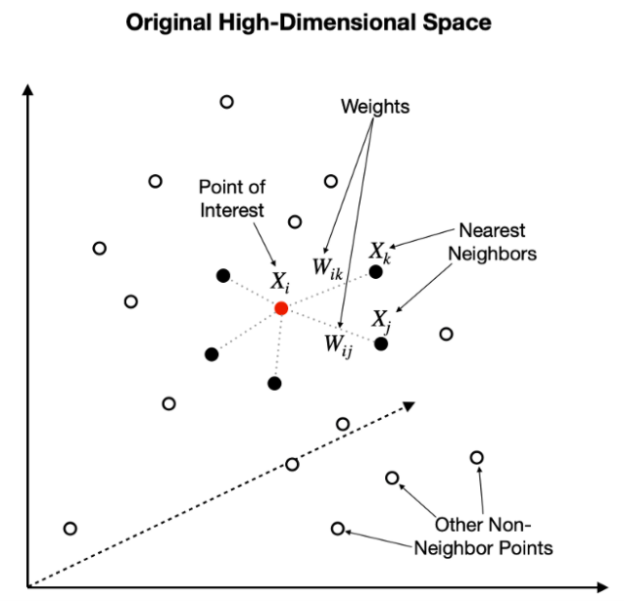
Locally Linear embedding
For each data point, identify k neighbors.
Represent this point as linear combination of its neighbors using initial random weights.
We get a weight matrix W.

Slide 29
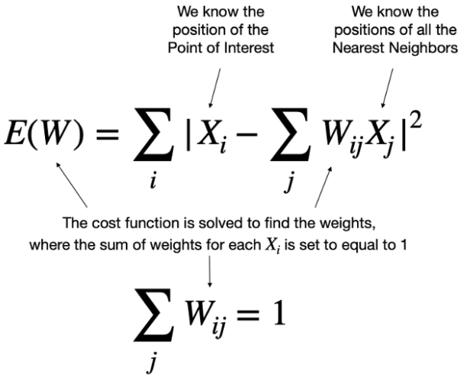
Locally Linear embedding

Slide 30
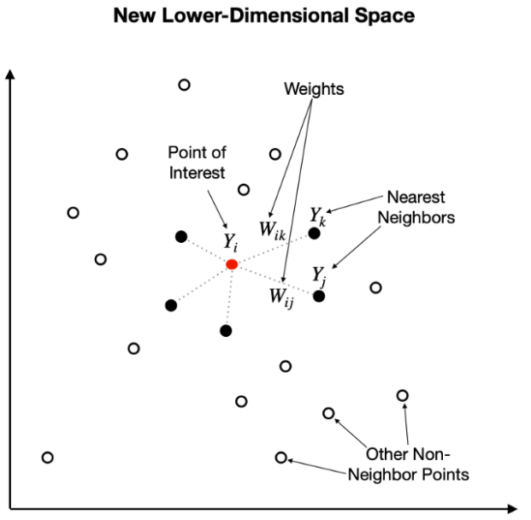
Locally Linear embedding
Map these points into lower dimensional space.

Slide 31
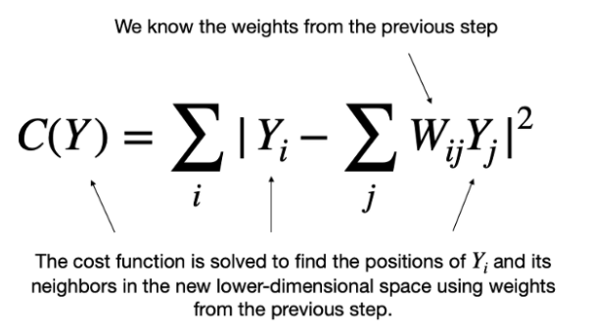
Locally Linear embedding

Slide 32
T- distributed Stochastic Neighbourhod Embedding

Slide 33
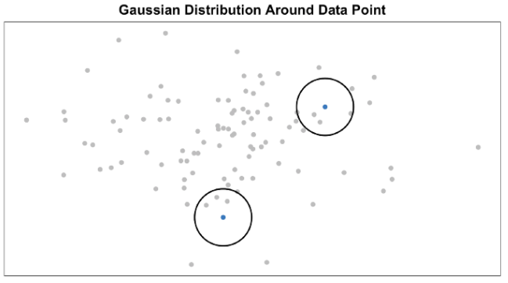
Original Stochastic Neighborhood Embedding
High dimensional data.

Slide 34
Stochastic Neighborhood Embedding
High dimensional data.
Consider a point Xi as the centre.
Consider the normal distribution with centre as xi.
xi

Slide 35
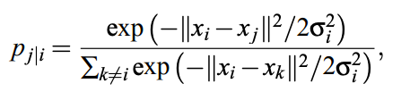
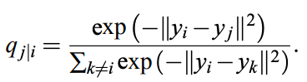
Stochastic Neighborhood Embedding
Mapping
Xi to yi
Respective conditional prob:
xj
xi
By adjusting variance= 1/ root(2)

Slide 36
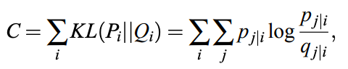
Stochastic Neighborhood Embedding
xj
xi
Minimise the Cost using Kullback-Leibler divergences

Slide 37
Stochastic Neighborhood Embedding
Problem with this mapping where distribution is Gaussian – crowding.
So, change the distribution from Gaussian to t.

Slide 38
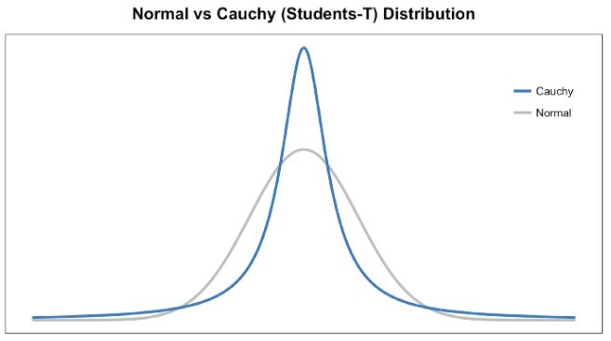
Stochastic Neighborhood Embedding

Slide 39
t-distributed Stochastic Neighborhood Embedding
xj
xi
Minimise the Cost using Kullback-Leibler divergences

Slide 40
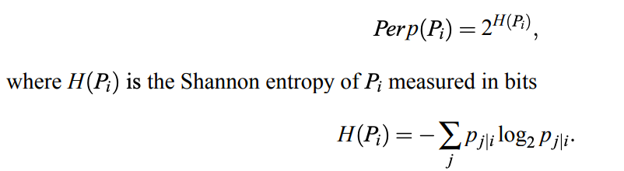
It uses a variable called perplexity.

Slide 41
https://www.jmlr.org/papers/volume9/vandermaaten08a/vandermaaten08a.pdf
https://distill.pub/2016/misread-tsne/

Slide 42
Which Dimensionality reduction
PCA: Linear, Variability is large, Projection
Factor Analysis: Based on correlation.
LDA: Linear, Projection, Class-focused.
LLE: Linear, Manifold learning
t-SNE: Non-linear. Manifold learning. Local and global characteristics preserved.

Slide 43
